Slide 1
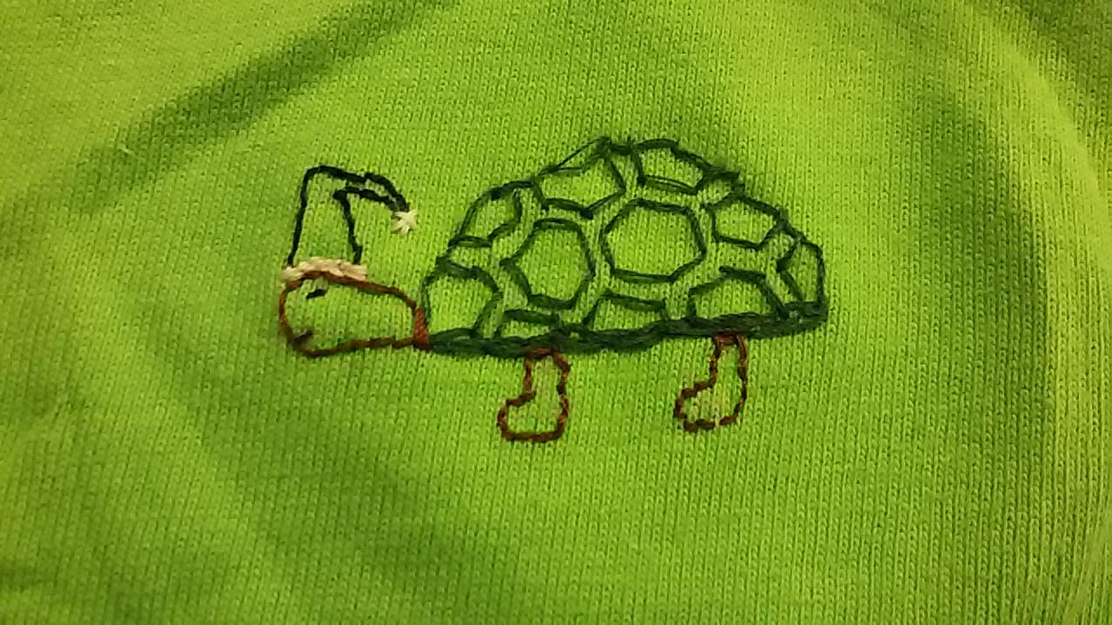
Nocturnal Knock Turtle
Shiyan Yang, Jackie Floyd, Ria Shroff, Andrew Travis, Maeve Tucker, Sam Pollinger

Slide 2
Overview
Problem identification
Design proposition
Customer requirements
Performance specs
Subsystems
Testing

Slide 3

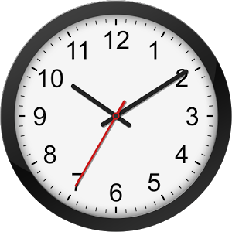
Problem Identification
Need to wake up on time
Roommate must not be disturbed
Wake up method must not be loud
Must not be excessively distracting
Must be effective
Notes:
One of the most annoying and preventable struggles students on campus face is dealing with their roommates. There are many issues they may face, however, one that can be solved is the issue of needing to wake up at different times and not wake each other up. Somehow, students need to wake up on time for classes, but also not disturb the precious sleep that their roommates get.

Slide 4
Design Propositions
Light
Gradual
Natural
Could turn away from
Easily obscured
Insufficient
Heat
Make uncomfortable
Isolated to user
Safety
Tolerance
Vibration
Confined
Safe
Not jarring
Sleep through
Speakers
Benefits
Drawbacks
Notes:
Once we identified the problem, we came up with three basic solution concepts. Our first idea was to create an alarm clock that uses light to wake the user. While this was an attractive idea because it would simulate natural waking conditions, it had many drawbacks mainly concerning how easily it could be ignored. The second idea was to create a device that would disrupt sleep by heating the bed and making it very uncomfortable. Like the first idea, we feared this could be insufficient to wake someone, but more so we were worried about the safety aspects of such a device. The idea we decided to proceed with is a pad of vibrating motors that’s inserted under one’s fitted sheet. If the alarm clock isn’t stopped, integrated speakers sound to supplement the vibration.

Slide 5
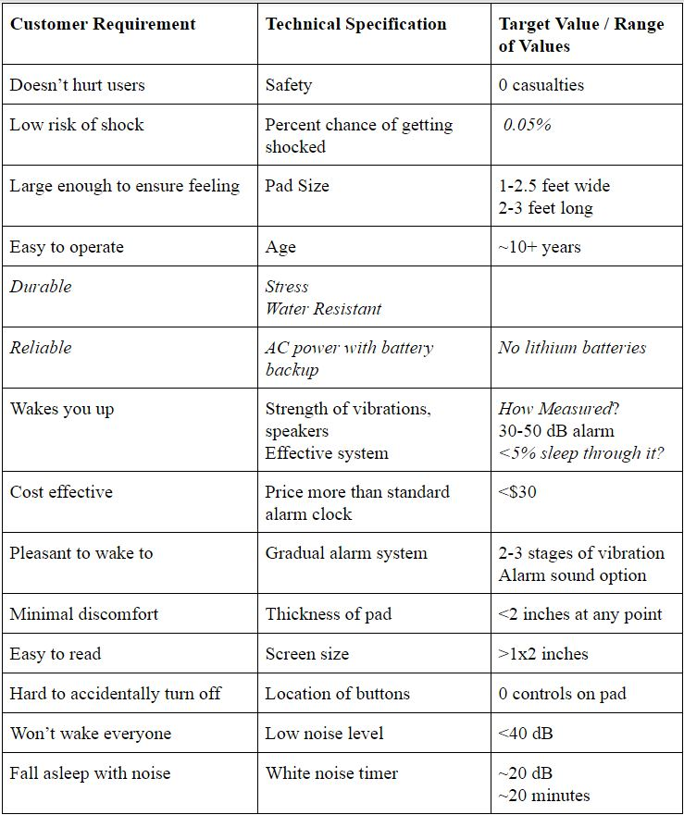
Prioritized Customer Requirements
Safety
Wires in pad
Wooden clock
Easy to operate
Screen
Buttons
Pleasant to wake up
Vibrations vs. loud noise
Doesn’t wake up your roommate
Notes:
Safety was the most prevalent concern since live wires were going into a pad placed in the customer's bed and in the wooden alarm clock case. Ease of operation was important so that anyone ages ten and up could use it easily. The screen displayed only the time and when you were changing the time or alarm time. The four buttons are clearly labeled with their function. One of the main goals of the project was to create a way to wake up with vibrations instead of a loud noise and to not wake up your roommate in the morning.

Slide 6
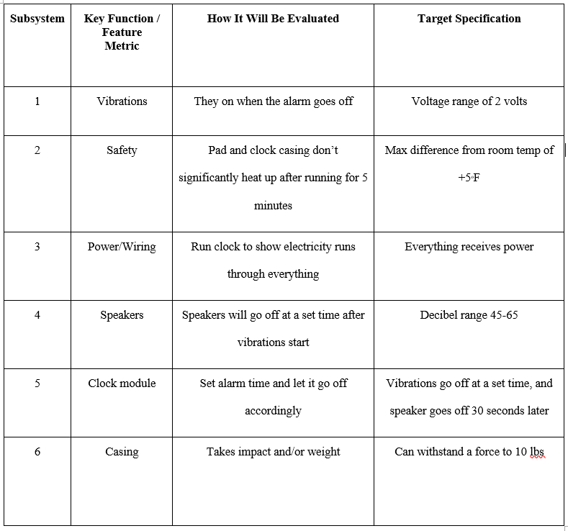
Performance Specs
Objective:
Meet the customer requirement
Meet the technical spec. We set for the product
Notes:
Shiyan

Slide 7
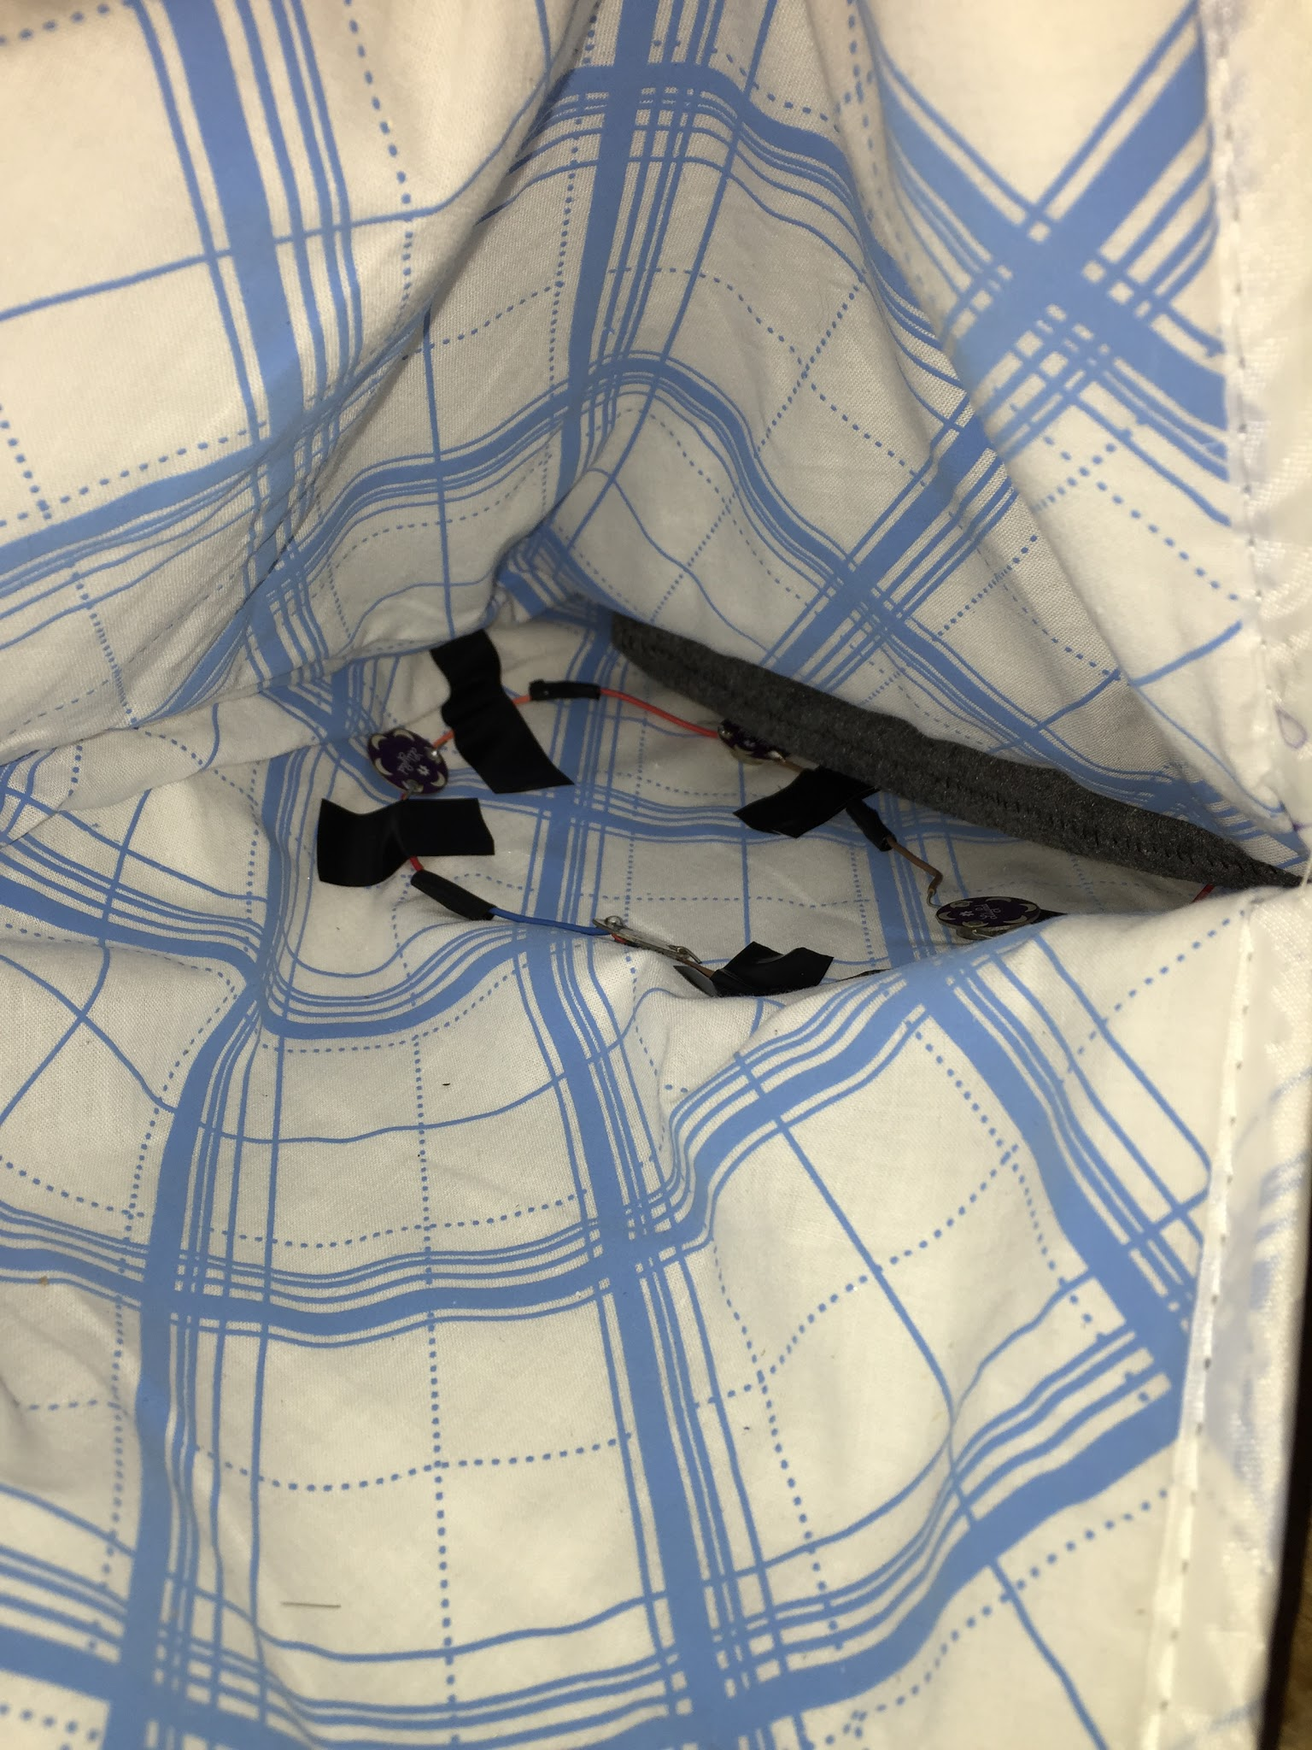
Safety
Subsystem Demo Results
Pad
Internal Components
Electrical Tape
Bare Wire
Solder Points
Wiring
Hollowed Out 120 Volt
Ironing pad
Moisture and heat resistant
Notes:
During the demo, the subsystem specification was to make sure the clock and pad did not get hotter than 5 degrees above room temperature. The pad was one degree above room temperature and the internal parts of the clock were roughly three degrees above. Electrical tape was used since it was easy to cover the bare wires with and was available from my house in large amounts. It was put on bare wire and exposed pins in the clock casing. 120 volt wiring was hollowed out and used to house the wires going from the clock to the pad. Ironing casing was used as the pad material since it is heat and moisture resistant. Also, it was thick and soft, making it a good material to have under a fitted sheet.

Slide 8
Casing
Considerations:
Material cost (ie. not cast solid gold)
Fabrication technique: 3D printer, laser cutter, wood/metal working shop, injection mold, casting
User Interface: Aesthetic, Durability, Weight, Size, Texture
Notes:
Casing Material considerations:
Material cost (IE not solid cast gold)
Fabrication technique: 3D printer, laser cutter, wood/metalworking shop
Durability
Aesthetic
How it did
Why did you do it this way/choose these materials?

Slide 9
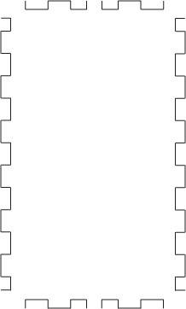

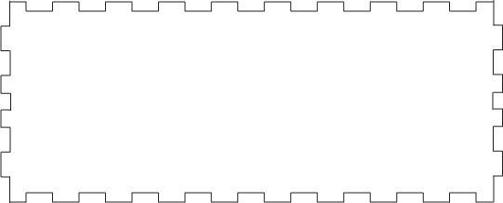
Casing

Slide 10
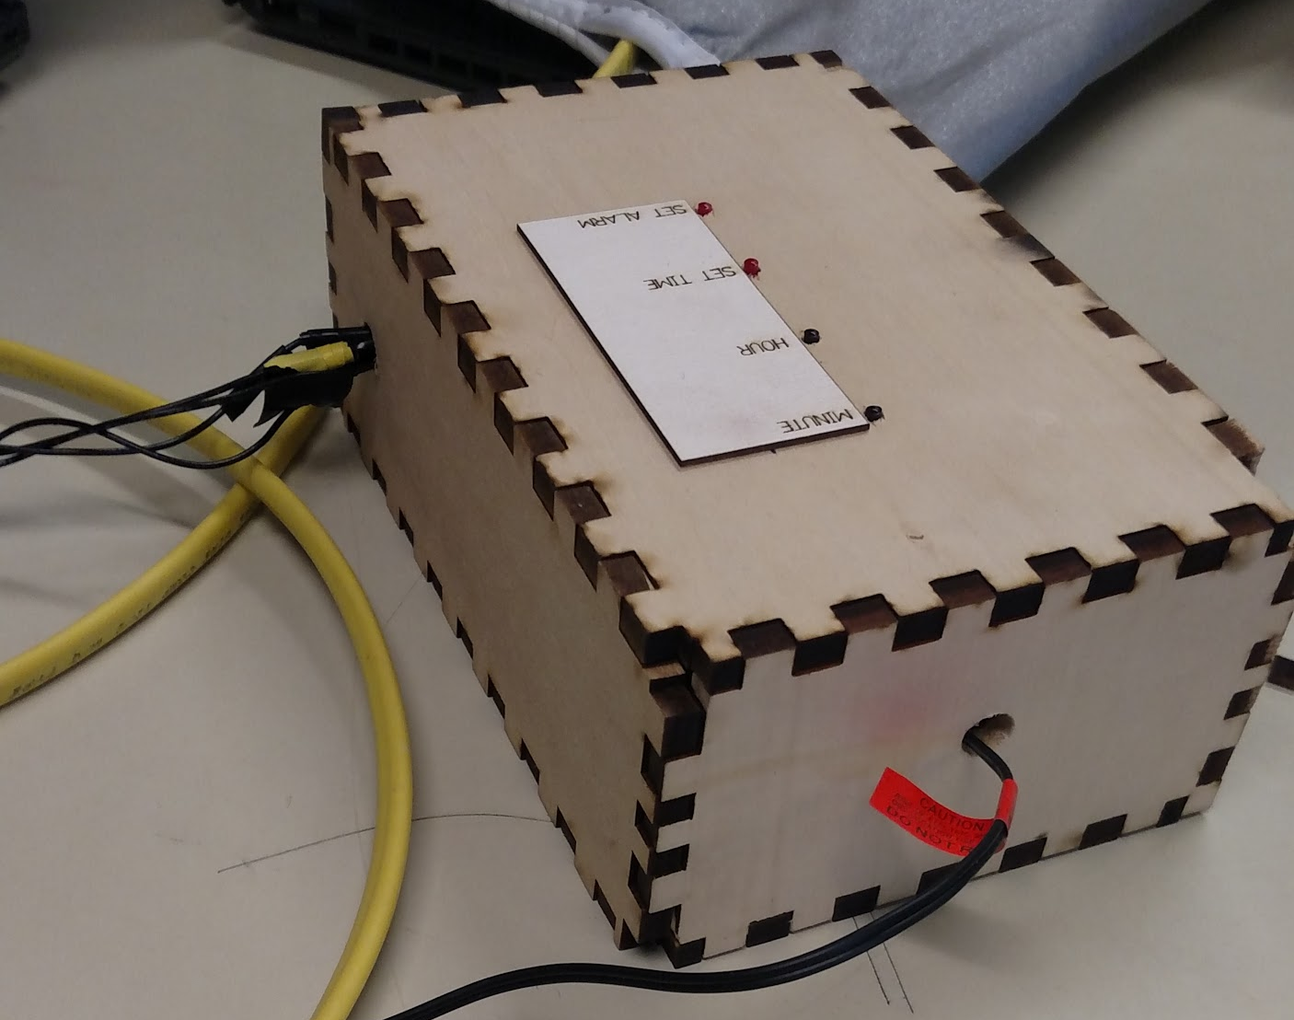
Casing

Slide 11
Power Supply
Arduino Uno requires a 7V - 12V DC supply.
A Power Cord used for a massaging pad with 12V DC output
Vibration Motor requires a secondary power supply
5 motors in series, powered by 2 9V-batteries
Notes:
Shiyan

Slide 12
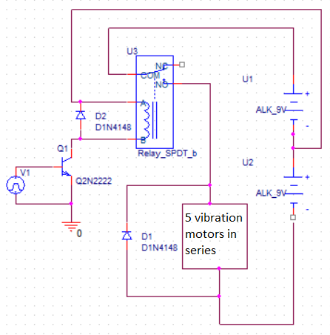
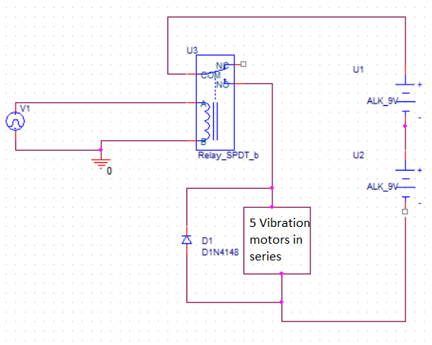
Power Supply
The Preferable Version

Slide 13
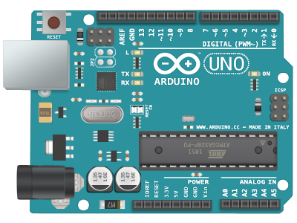
Clock Module
Arduino
Ease of use
Easy to make adjustments
Great for Prototyping
Notes:
Switch the slide when I mention the “2 ands” thing

Slide 14
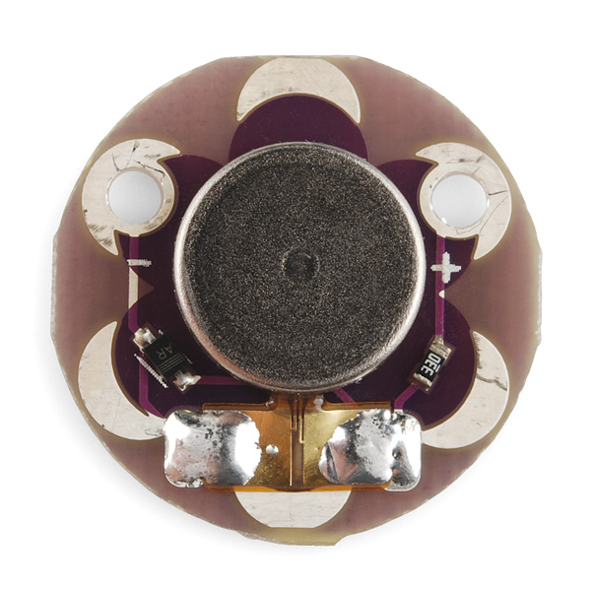
Vibration
5 LilyPad Vibe Board motors used
Why did we choose that motor?
Size
Power per cost
Online reviews
Durable
LilyPad Vibe Board [1]
Notes:
Jackie
To make the alarm clock pad vibrate, we used 5 small vibrating motors.
One reason we chose the LilyPad Vibe Board motors was for their small size, so the pad that you sleep on wouldn’t be lumpy. They had a good power to cost ratio compared to other motors available from the same seller. The reviews on the website we bought them from were also positive. These motors are actually designed for wearable applications, so we thought they would be a really good fit for our project, and they come mounted on a small plastic board, which makes them less likely to be damaged.

Slide 15
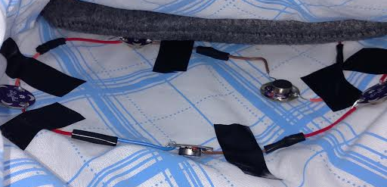
Vibration: Application
Motors connected in series to ensure enough voltage and limited current
Circular arrangement in pad to concentrate vibration, near where the upper back would be
Notes:
The motors are wired in series so that they can each receive enough power to be vibrating at their maximum potential. The motors are arranged in a circle, a couple of inches apart from each other inside the pad, at about where a person’s upper back would be, because that is where they will be best felt by the user. They are arranged in a circle to concentrate the vibration.

Slide 16
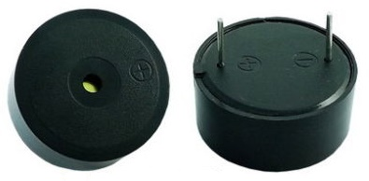
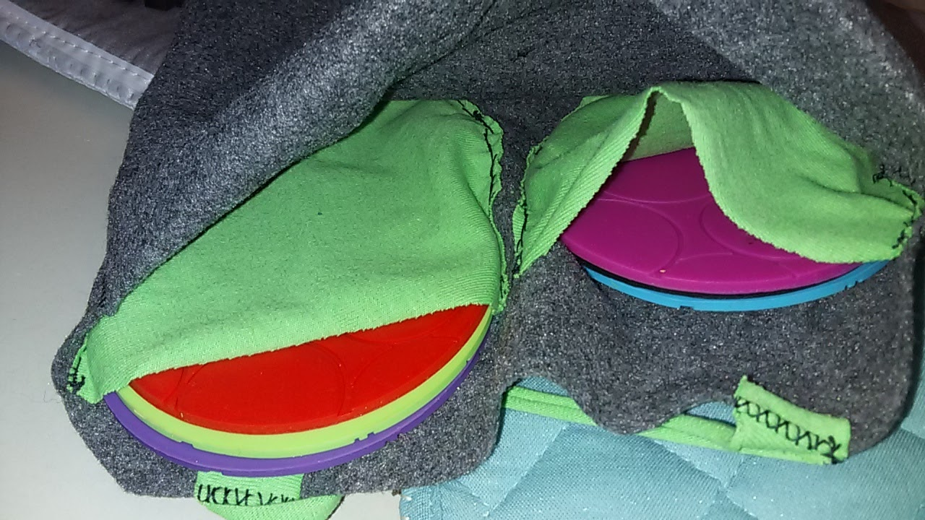
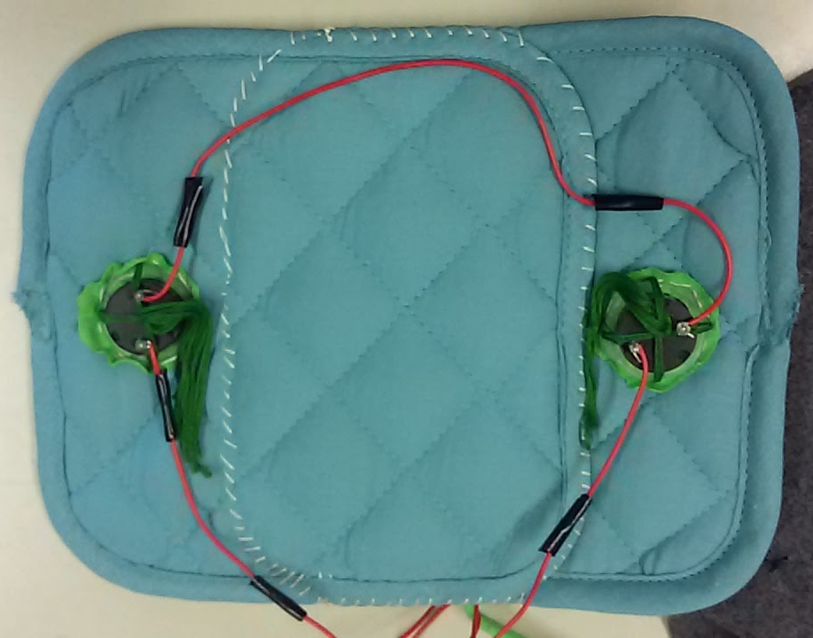
Speakers
2 piezoelectric buzzers
Plastic casing
Hard to overload
Cost efficient
Limited tone range
Set Volume
User controls insulation
Fabric with removable silicone inserts
Allows easy customization
[2]
Notes:
For the speakers, we chose to use 2 small piezoelectric buzzers. These are perfect for our application because the black plastic casing they come in is durable yet small enough to be used in the pad without creating noticeable hard lumps. They also have a long lifespan and are very hard to overload. The buzzers have a small tone range and a set volume, but these features were not necessary for our purposes. The buzzers were secured to a mat to provide sound insulation, prevent them from moving around, and to cushion the surface that will be laid upon. For ease of use, the customer can change the alarm volume by either adding or removing silicone pads from pockets that lay over the speakers.
Red = click for animation

Slide 17
Testing
Continuous testing throughout the building process
Testing of each subsystem separately, and the unit as a whole
Demo day: all subsystems met specifications
Notes:
Because of the nature of our project, we had to continuously test, because any small change to the code or the circuit could change how the system works together. We tested each subsystem component on its own to make sure it was capable of meeting the standards we set, as well as the unit as a whole to make sure everything was integrated and still functioning at its best.
On demo day, all subsystems functioned as we expected and met the specifications that we set.
We tested the … by...

Slide 18
Questions?

Slide 19
References
[1] LilyPad Vibe Board. (n.d.). Retrieved March 14, 2017, from https://www.sparkfun.com/products/11008
[2] http://www.taydaelectronics.com/datasheets/A-5019.pdf
[3] https://www.ponoko.com/blog/how-to-make/how-to-design-a-la ser-cut-interlocking-box/

